Slide 1
Digital Image Processing
Session 11

Slide 2
Image Rectification
Satellite imagery are not in ready to use format due to several limitations such as geometric accuracy, environmental conditions such as haze etc.

Slide 3
Pre-Processing
Prior to data analysis, initial processing on the raw data is usually carried out to correct for any distortion due to the characteristics of the imaging system and imaging conditions.
Depending on the user's requirement, some standard correction procedures may be carried out by the ground station operators before the data is delivered to the end-user.
These procedures include radiometric correction to correct for uneven sensor response over the whole image and
geometric correction to correct for geometric distortion due to Earth's rotation and other imaging conditions (such as oblique viewing). The image may also be transformed to conform to a specific map projection system. Furthermore, if accurate geographical location of an area on the image needs to be known, ground control points (GCP's) are used to register the image to a precise map (geo-referencing).

Slide 4
Geometric Distortions: What and why
Remotely sensed imagery typically exhibits internal and external geometric error. It is important to recognize the source of the internal and external error and whether it is systematic (predictable) or nonsystematic (random). Systematic geometric error is generally easier to identify and correct than random geometric error
It is usually necessary to preprocess remotely sensed data and remove geometric distortion so that individual picture elements (pixels) are in their proper planimetric (x, y) map locations.
This allows remote sensing–derived information to be related to other thematic information in geographic information systems (GIS) or spatial decision support systems (SDSS).
Geometrically corrected imagery can be used to extract accurate distance, polygon area, and direction (bearing) information.

Slide 5
Geometric distortions
All remote sensing imagery are inherently subject to geometric distortions. These distortions may be due to several factors, including:
The perspective of the sensor optics
The motion of the scanning system
The motion of the platform
The platform altitude, attitude, and velocity
The terrain relief; and
The curvature and rotation of the Earth.
Geometric corrections are intended to compensate for these distortions so that the geometric representation of the imagery will be as close as possible to the real world.

Slide 6
Image Enhancement
In order to aid visual interpretation, visual appearance of the objects in the image can be improved by image enhancement techniques such as grey level stretching to improve the contrast and spatial filtering for enhancing the edges. An example of an enhancement procedure is shown here.

Slide 7
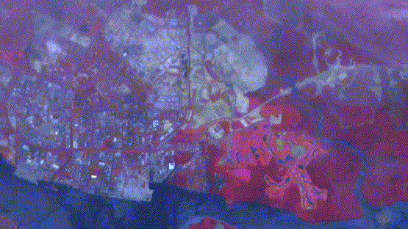
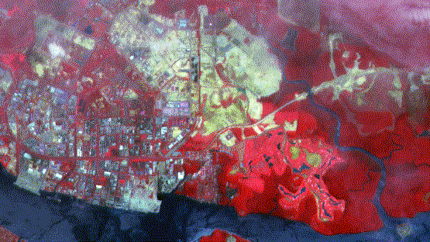
Image Enhancement
In the above unenhanced image, a bluish tint can be seen all-over the image, producing a hazy appearance. This hazy appearance is due to scattering of sunlight by atmosphere into the field of view of the sensor. This effect also degrades the contrast between different landcovers.
The result of applying the linear stretch (one of the methods for image enhancement) is shown in the following image. Note that the hazy appearance has generally been removed, except for some parts near to the top of the image. The contrast between different features has been improved.

Slide 8
Image Classification
Different landcover types in an image can be discriminated using some image classification algorithms using spectral features, i.e. the brightness (spectral resolution) and "colour“(spatial resolution) information contained in each pixel.
The classification procedures can be "supervised" or "unsupervised".

Slide 9
Image Classification
In supervised classification, the spectral features of some areas of known landcover types are extracted from the image. These areas are known as the "training areas". Every pixel in the whole image is then classified as belonging to one of the classes depending on how close its spectral features are to the spectral features of the training areas.
In unsupervised classification, the computer program automatically groups the pixels in the image into separate clusters, depending on their spectral features. Each cluster will then be assigned a landcover type by the analyst.
Each class of landcover is referred to as a "theme“ and the product of classification is known as a "thematic map".

Slide 10
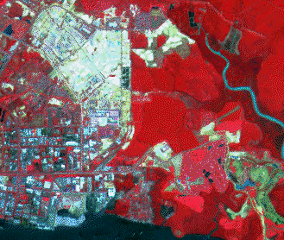
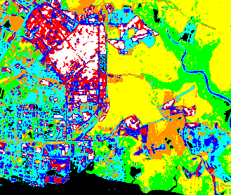
Image Classification
The following image shows an example of a thematic map. This map was derived from the multispectral SPOT image using an unsupervised classification algorithm.
Class No. (Colour in Map) | Landcover Type
1 (black) | Clear water
2 (green) | Dense Forest with closed canopy
3 (yellow) | Shrubs, Less dense forest
4 (orange) | Grass
5 (cyan) | Bare soil, built-up areas
6 (blue) | Turbid water, bare soil, built-up areas
7 (red) | bare soil, built-up areas
8 (white) | bare soil, built-up areas
SPOT multispectral image
Thematic map derived from the SPOT image using an unsupervised classification algorithm.

Slide 11
Accuracy of Image Classification – Presentation tomorrow
5 minutes presentation tomorrow for each!!
Should cover the following:
Image classification technique: Pixel based and object based
Types of unsupervised classification method
User Accuracy
Producer Accuracy
Confusion Matrix
Kappa Statistics
Types of image enhancement

Slide 12
End of Session

